Slide 1

servers
Notes:
BRIAN:

Slide 2
Serverless Going beyond the obvious
Notes:
BRIAN

Slide 3



Jack Warner
jack.warner@parivedasolutions.com
/jackwarner
Phillip Manwaring
phillip.manwaring@parivedasolutions.com
/manwaring
Notes:
BRIAN

Slide 4
Your business doesn’t have technology problems
Notes:
PHILLIP

Slide 5

Notes:
PHILLIP

Slide 6
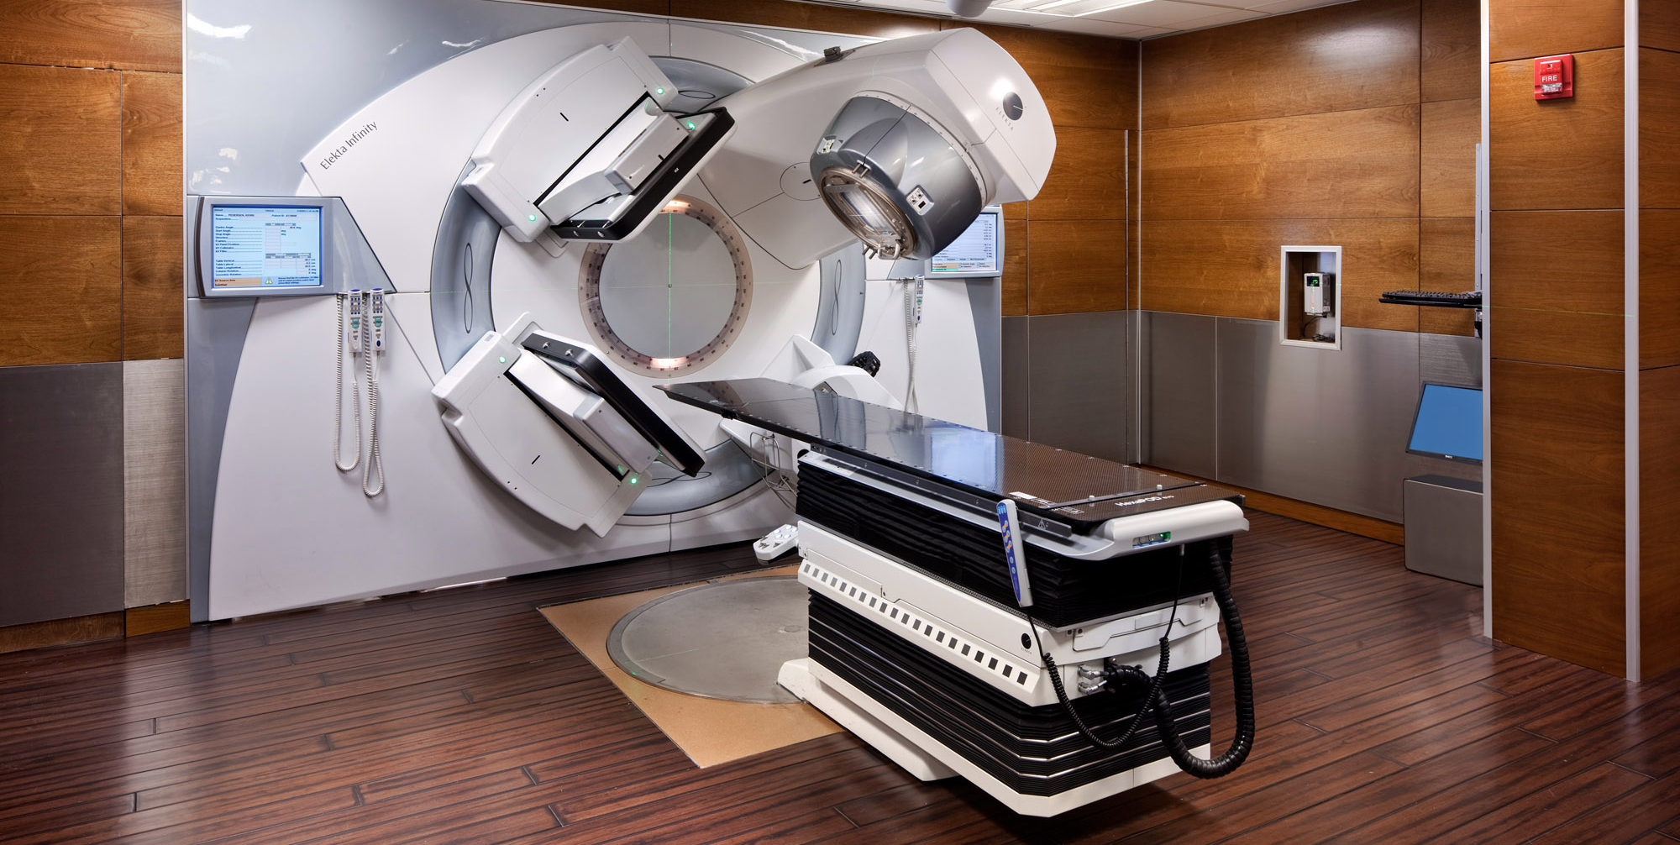
Notes:
PHILLIP
Stereotactice radiosurgery machines like the GammaKnife

Slide 7
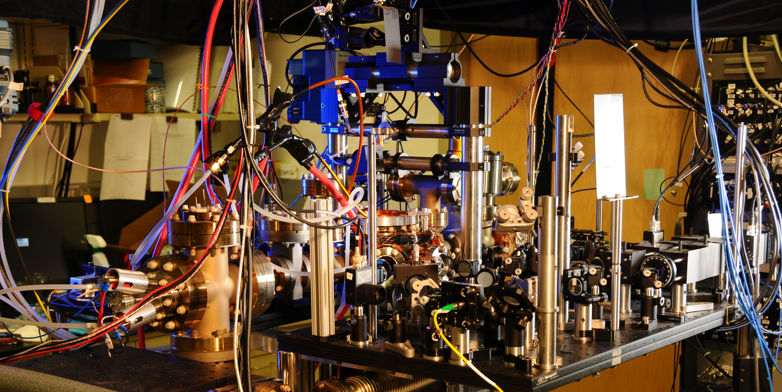
Notes:
PHILLIP
Global transaction consistency

Slide 8
You still have problems
Notes:
PHILLIP

Slide 9

Notes:
PHILLIP
Coping with industry-wide changes in modes of revenue and distribution

Slide 10

Notes:
PHILLIP
Connecting with and understanding customers and what they want, establishing loyalty in an age when everything can be compared online

Slide 11

Notes:
PHILLIP
Social mission, such as improving educational outcomes

Slide 12
You don’t have technology problems
Solving technology problems isn’t your business
Notes:
PHILLIP

Slide 13





20 - 40%
40 - 60%
60 - 80%
Notes:
PHILLIP:
What percentage of your IT organization’s time is spent solving your business problems?

Slide 14
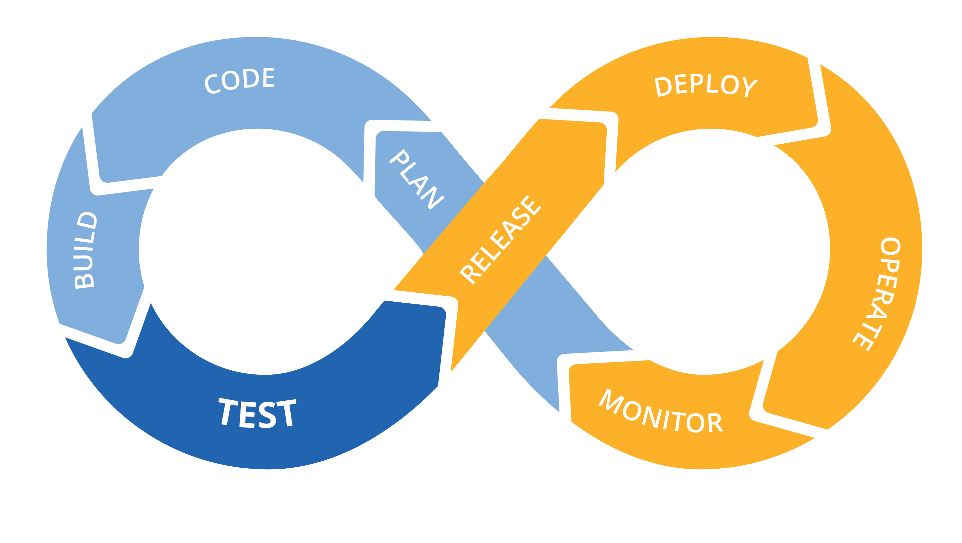
Notes:
PHILLIP:
DevOps is the combination of cultural philosophies, practices, and tools that increases an organization’s ability to deliver applications and services at high velocity: evolving and improving products at a faster pace than organizations using traditional software development and infrastructure management processes. This speed enables organizations to better serve their customers and compete more effectively in the market. Under a DevOps model, development and operations teams are no longer “siloed.”
8-9 years

Slide 15
Energy
 | Time
Notes:
PHILLIP
Associations? Bunsen burners?

Slide 16



Energy
 | Time
Activation energy
Notes:
PHILLIP
Chemical reaction. High energy to low energy state, note activation energy required

Slide 17
Technology problems
 | Time
Difficulty of the change
Time required for change
Notes:
PHILLIP
Useful analogy for IT change and moving from current state to better state

Slide 18
Technology problems
 | Time
Catalysts change the equation
Notes:
PHILLIP
Catalyst reduces time and energy required for change

Slide 19
Technology problems
 | Time
Serverless
is the catalyst
Catalysts change the equation
Notes:
PHILLIP
Jack’s going to talk more about what we mean when we’re talking about serverless

Slide 20


f(n) + +
Notes:
So if serverless is the catalyst, what’s serverless?
First of all, spoiler alert. Yes, there are still servers. While we all agree on that, the exact definition is a bit fuzzier.
So for the purposes of today’s discussion, when we say ‘serverless’, we mean a combination of three things:
Short-lived functions that come into existence when requested, execute business logic, then disappear. You only pay for them when they are being used. AWS refers to this as ‘scalability as a service’, which is a great way to think about it
Managed services. Any tech professional knows that it takes a lot to keep an enterprise database performing the way you expect it to, or that DNS servers don’t configure themselves. In the world of managed services, however, they mostly do.
Lastly, the supporting tools and Frameworks that make developing in this brave new world a bit easier.

Slide 21

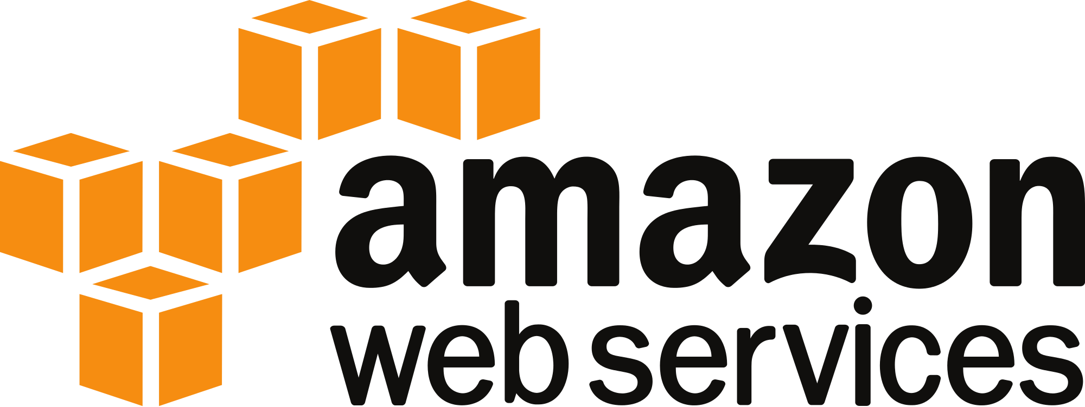



f(n) + +
Notes:
That definition translates to some distinct services and providers:
In the function space, AWS offers Lambda and Microsoft offers Azure Functions. At the moment, each is limited to a subset of the programming languages available, but we expect the number of supported languages to expand over time.
In the managed services space, both AWS and Microsoft offer a range of services across compute, database, storage, and networking. Popular offerings that fit this model from AWS include DynamoDB, S3, and API Gateway/Route 53.
Finally, the Serverless Framework, an open source tool from Serverless Inc, is our favorite for the build/deploy/test loop. Others exist, but this is the one we know the best right now.
So what does this combination of technologies mean for keeping me focused on business problems?

Slide 22

Notes:
Well, we’ve all heard about DevOps OZ, but getting there has remained elusive for many of us.
Why is that?
Despite some great tooling out there to make infrastructure automation easier, you still have to do infrastructure automation. Tools like Chef, Ansible, and Puppet are powerful options in this space, but they require a blend of both deep infrastructure knowledge, and some non-trivial design, code dev and test, and release work.
Docker was a stride forward, but neither approach reduces the friction of doing things right.
We think serverless is the yellow-brick-road to DevOps because it makes doing the right thing the path of least resistance. The instruction set really couldn’t be much easier – follow the yellow brick road of serverless, and DevOps OZ will be right around the corner.

Slide 23

Small, product focused teams
Notes:
If serverless makes doing things the right way the easy way, one place we’ve seen that to be truer than ever is when it comes to team size.
Large teams suffer from numerous dependencies and an explosion of possible communication paths. They’re too far removed from customer feedback to be able to course—correct in a reasonable amount of time.
In a serverless world, the benefits of small teams are more easily achievable. So much of the specialized knowledge required to run an enterprise is now the cloud provider’s responsibility.
Focus your people on the product, and avoid the temptation to load up on headcount. You’ll be glad you did.

Slide 24
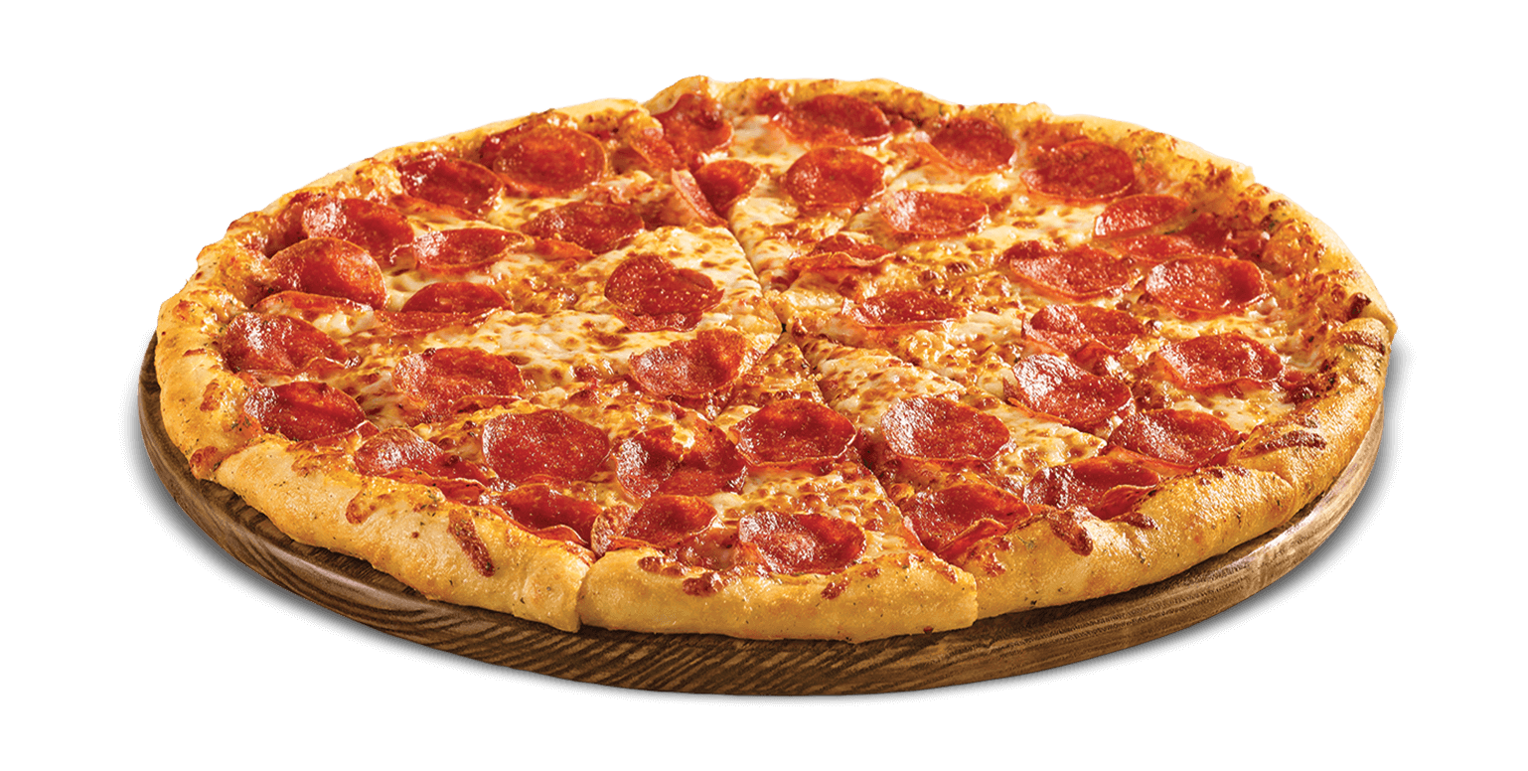
Notes:
If serverless makes doing things the right way the easy way, one place we’ve seen that to be truer than ever is when it comes to team size.
Large teams suffer from numerous dependencies and an explosion of possible communication paths. They’re too far removed from customer feedback to be able to course—correct in a reasonable amount of time.
In a serverless world, the benefits of small teams are more easily achievable. So much of the specialized knowledge required to run an enterprise is now the cloud provider’s responsibility.
Focus your people on the product, and avoid the temptation to load up on headcount. You’ll be glad you did.

Slide 25
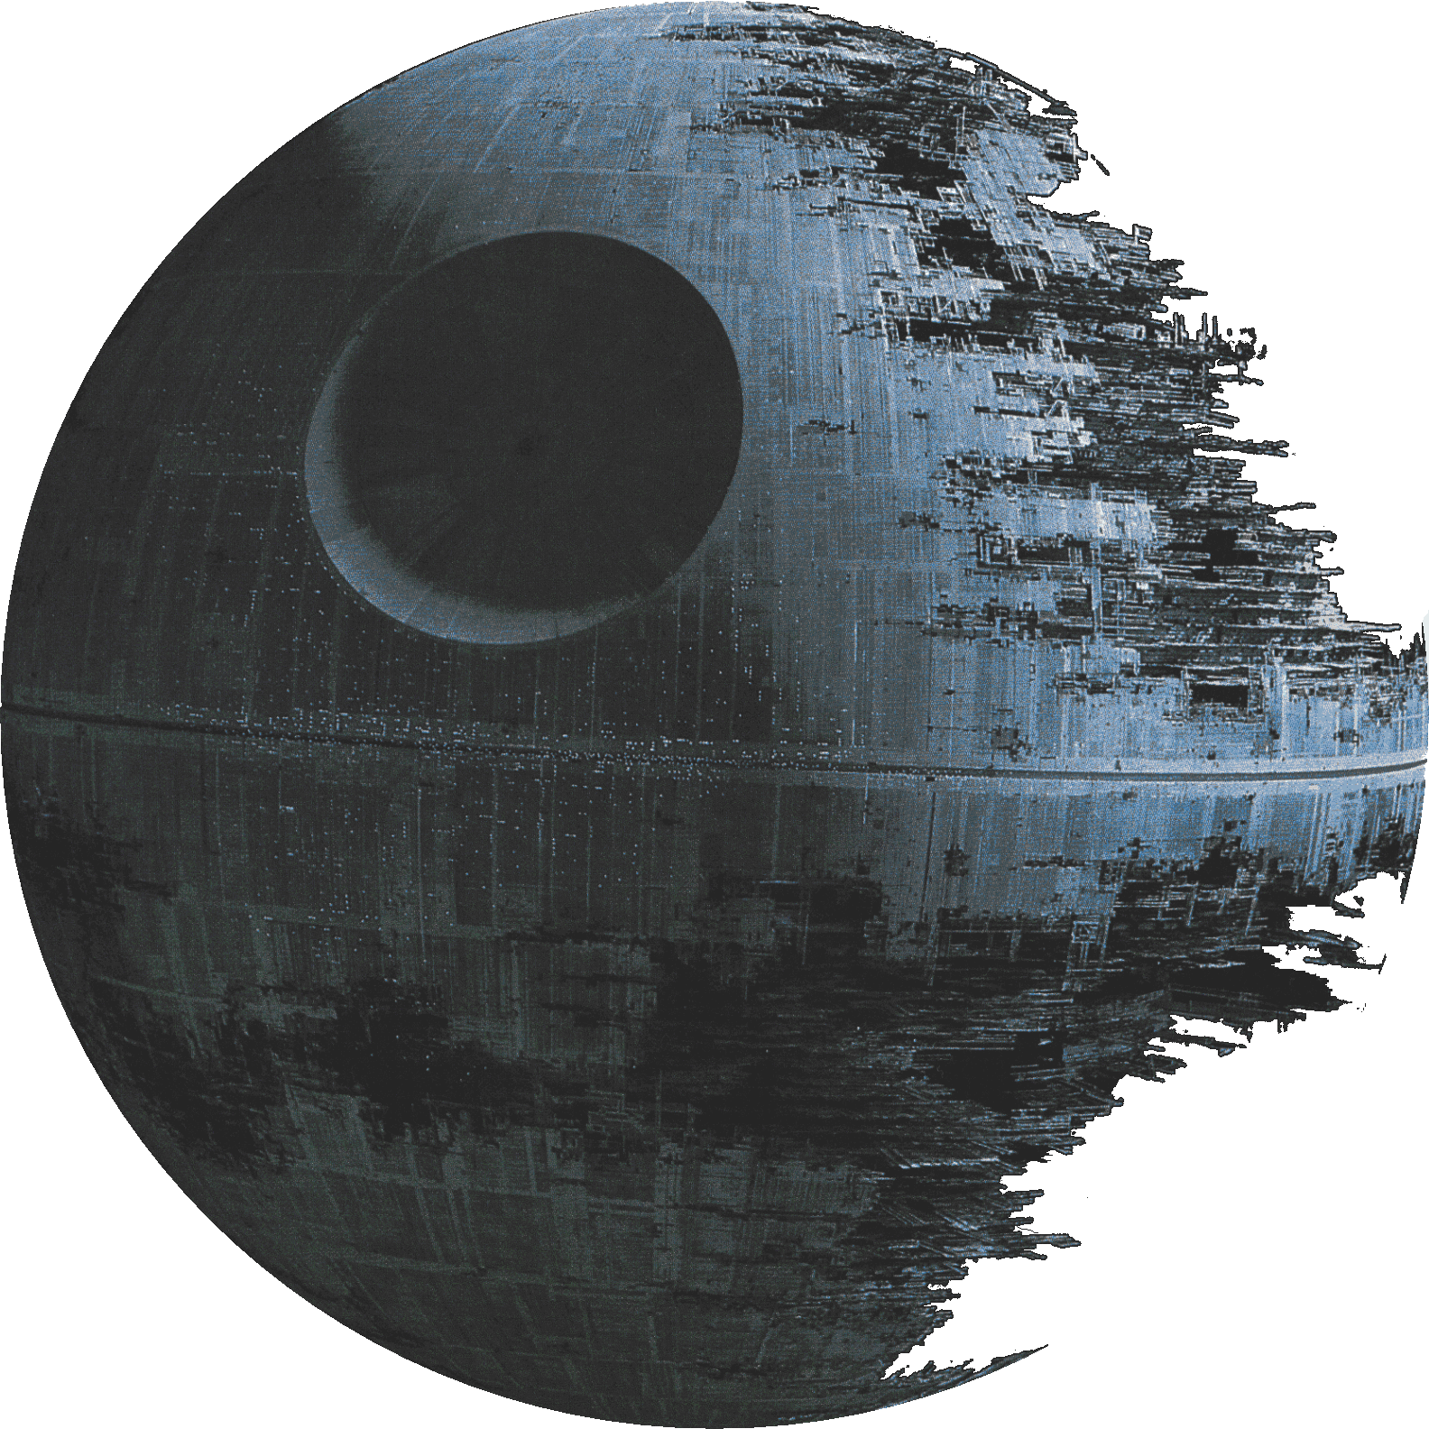
Notes:
Who here has been part of an IT project that was originally planned to last over a year?
[interact with the audience]
Don’t raise your hand too high – we don’t want to breed resentment.
In all seriousness, you’re lucky. Depending on your source and how you define ‘large’, somewhere between 50 and 80% of software projects fail in some aspect of delivery.
If viewed in the right light with some enabling architectures, projects can go from months or years to days or weeks.

Slide 26

Faster Time-to-Market
Notes:
Which is really what serverless is all about – faster Time to market.
It levels the playing field, and let's us all be cheetahs.

Slide 27


Notes:
But honestly, nothing we just shared so far is controversial, and you’ll begin to see those benefits right away.
Let’s move on to some things we think are less obvious, but still powerful.
It obvious that mission-critical software is key to how you do business.
It’s obvious that you need to both govern and support it.
In doing so, you probably made some reasonable choices about what’s in and out of your ecosystem.
so you standardize on Java, or become a Microsoft shop.
But while the technology world around us grows in complexity and diversity, we stagnate and dry up, because we can’t decouple the cost of governance from taking advantage of new and innovative technologies.
serverless will change all that.
Through built-in automation, function decomposition, and code-driven access control, we can make the governance cost remain constant as overall system complexity grows.

Slide 28


Data driven decision making
Notes:
PHILLIP
Data driven decision making, not based on HiPPO, anecdotes, etc.

Slide 29

Notes:
PHILLIP:
If relying on large efforts to change the organization and add business value, putting all your eggs in a single basket
Implies being able to clearly see the end from the beginning
Huge opportunity cost
Feel your way along and change to what’s working better

Slide 30

Notes:
PHILLIP
When your people have been freed to focus on problems, maybe instead of running the experiments themselves like our hero in the Unilever story, they’ll write systems that run the experiments for them.
In the future, when
serverless is the norm,
usage data is granular, abundant, and accessible, and
machine learning moves further into the commodity space
The heroic experimentor will be the machine. The idea of software products and services assembling themselves based on ML models isn’t quite as crazy as it sounds.

Slide 31
Technology problems
 | Time
Notes:
We think it’s harder to imagine a future without these characteristics than one with them.
But no matter how well-informed our opinions may be, we don’t write the future.
So let’s come back to that chart from high school chemistry.

Slide 32

Technology problems
 | Time
Notes:
While we can’t see the future, we know with certainty what a continuation of the past looks like.
It’s business as usual, inability to attract or retain talent, and IT cost-cutting until it feels like you are trying to get blood from a stone.
In short, it’s spending all your time solving problems that aren’t business problems.

Slide 33


Technology problems
 | Time
Notes:
Serverless is a unique opportunity to free your people’s brains and their time to solve business problems instead of IT problems
While we may not be able to imagine exactly where your path leads you, we think you’ll drastically improve your odds of
- unlocking revenue
- growing business
And driving innovation
But if you choose to be the author of your organization’s future, you’ll have to start the journey somehow.

Slide 34




Notes:
We warned against death star projects earlier, and we don’t think you should start a 3 year multimillion dollar serverless transformation project.
Some words of wisdom:
Start small
Identify opportunities that build momentum
Adopt an evolutionary mindset – embrace change
The most valuable tools are the ones that exist. Build the muscle memory to release early and often.

Slide 35







Notes:
It may feel a bit daunting, but you’re not alone.
These companies have already begun the journey. They have two things in common: they are adopting serverless, and solving technology problems isn’t their business.

Slide 36
servers

